Slide 1

Outland Adventures
Taylor Nairn, Benjamin Andrew, Joshua Rex
Database Development and Use, 7/21/2023

Slide 2


The Case Study
Blythe Timmerson and Jim Ford opened Outland Adventures to allow customers to hike and camp in treks in other countries. With their guides, John 'Mac' MacNell and D.B. 'Duke' Marland, Outland Adventures has seen much success. Anita Gallegos was hired to take the lead on marketing and Mei Wong was hired later to develop a website for the Outland Adventures franchise.

Slide 3
The Case Study
Now that Outland Adventures is operating smoothly, Blythe and Jim are interested in optimizing their organization. The questions they have asked are these:
Does the company sell enough equipment to justify keeping a store or is renting more efficient? Is there a specific location that has a downward trend in bookings? Is there anything in the inventory that is over five years old?

Slide 4

The Problems
So far, they have conducted treks in Africa, Asia, and Southern Europe. Is there any one of those locations that has a downward trend in bookings?
Are there inventory items that are over five years old?
Do enough customers buy enough equipment to keep equipment sales?

Slide 5
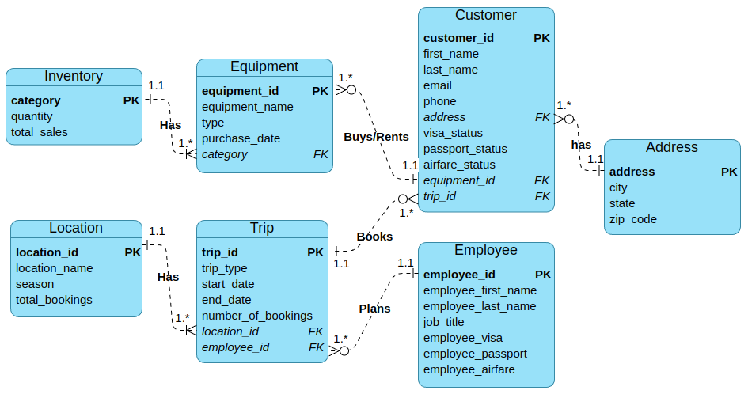
The Design of the Database

Slide 6

Report #1: Trends
Step 1: Organize each trip by location name and start date.
Step 2: Print out the number of reservations for that trip.
Step 3: Calculate whether there was an increase or decrease in bookings for that trip.
Step 4: Display the difference in reservations as a percentage.

Slide 7
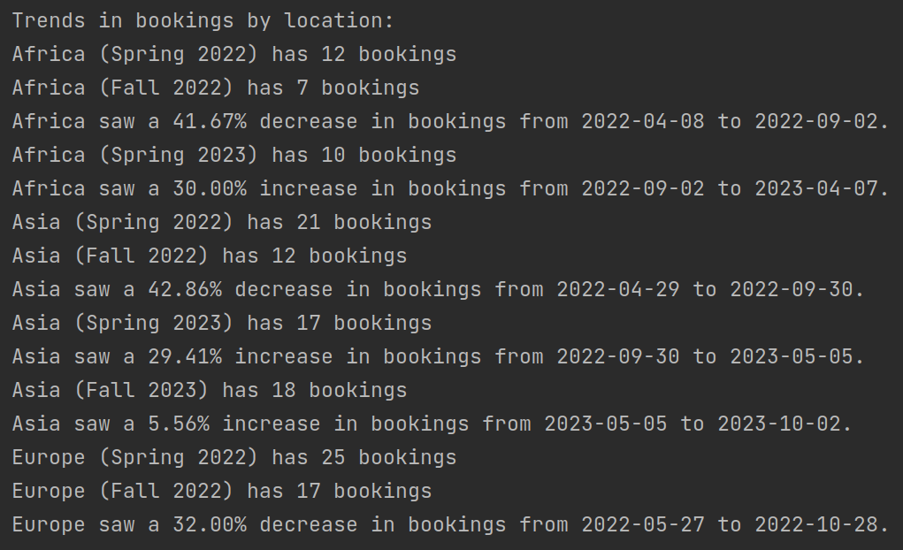

Report #1: Trends Output

Slide 8
Report #2: Expired Inventory
Step 1: Gather all pieces of equipment and their respective purchase dates into a single table.
Step 2: Check if any items were purchased five or more years ago.
Step 3: Display any items in the database that meet both of those conditions.

Slide 9
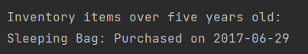
Report #2: Expired Inventory Output

Slide 10
Report #3: Total Equipment Purchases
Step 1: Use the aggregate function "COUNT" on all equipment purchases contained in the customer table.
Step 2: Display the result.

Slide 11

Report #3: Total Equipment Purchases Output

Slide 12

Assumptions made in the Design:
Each customer has a unique CustomerID.
Each trip has a unique TripID.
Each equipment item has a unique EquipmentID.
Each employee has a unique EmployeeID.
Each inventory item has a unique Category.
The age of an equipment item can be calculated based on the purchase date.

Slide 13
Assumptions made in the Design:
Equipment is specified for rent or sale.
If used equipment is sold it is first declassified as rental inventory.
There can be multiple customers participating in a trip.
There can be multiple trips organized by a guide.
An employee can have only one job title at a time.

